Slide 1
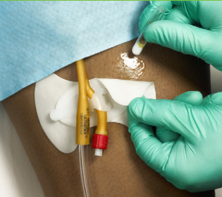
Mastisol®
Notes:
Good Morning team! I see everyone is getting logged on to the GoToMeeting. We will give the rest of the group a few more minutes to get logged on before we officially start. We have a lot to go through so we will start at the top of the hour.
START RECORDING
Introduction: Hi Everyone, I am Crysta Seneski, the brand manager for Mastisol and Detachol. I haven’t had the opportunity to meet most if you in person yet, but I look forward to doing so next week at the NSM.
In today’s webinar, we are actually going to be going through 2 brand Product introductions: Mastisol & Detachol. Format will be similar to that which you sat in on last week for ReliaFit. But we are doing this for 2 brands. We will do our best to get through this content as quickly as possible, but it will be a bit longer than your last ReliaFit webinar. We do have a lot of content to go through, so I hope everyone is comfortable and settled in a quiet place.
Anyway, I know the group on this call is going to be going through a greater depth of information at Next week’s NSM. However, we just want to ensure that when you all participate in the training at the NSM that you have all of this product specific background for Mastisol and Detachol fresh in your minds, so that is why we are going through this today
Housekeeping notes:
MUTE: As we’ve done with other GoToMeetings in the past, I am going to put you all on mute so as to not distract everyone with background noise.
QUESTIONS: I will open up the lines at a couple of points throughout the call to ensure you have the opportunity to ask any questions that you have. You can also type your questions into the side-bar of the GoTo Meeting as well, and we will address them as we go through.
RECORDING: This webinar will be recorded if in case you miss anything and want to re-listen to any portion of the webinar in the future. We will make that available on Sharefile along with some of your other training materials.
I want to be conscious of your time and be sure to allow for time for questions. So with that said, let’s get started...

Slide 2
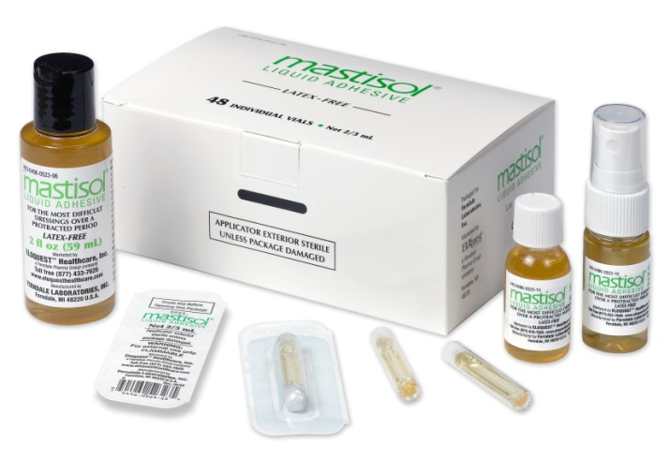
Adesivo Líquido Mastisol®

Slide 3
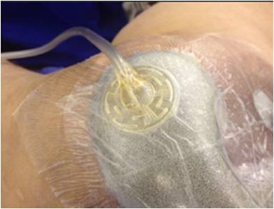
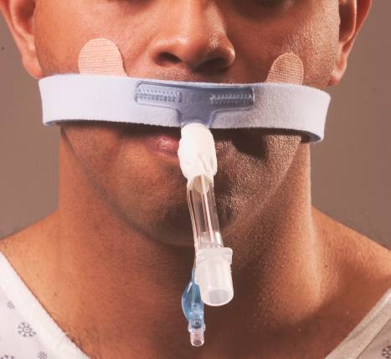
Mastisol® - Indicações
Curativos para catéter
Curativos NPWP (Terapia de feridas por
pressão negativa)
Tubo endotraqueal
Notes:
Detachol is applied to the edge of tape, dressing or device until it is saturated. While gently pulling the tape, dressing or device corner, Detachol is continuously applied as the adhesive is completely removed. The skin is then cleansed with mild soap and water or approved skin cleanser. Detachol is versatile and can be used to remove virtually any dressing, tape, or adhesive residue left behind. Below described are several common dressings and devices that benefit from effective adhesive removal:

Slide 4
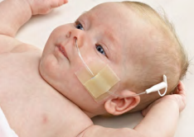
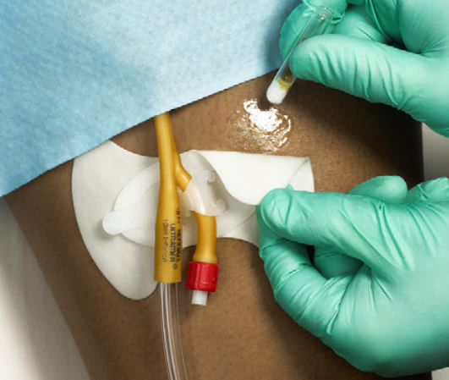
Sonda nasogástrica
Curativos periféricos IV
Notes:
Alcohol-based adhesive removers can strip the skin of its natural lipids. This can cause irritation, dryness, redness, bleeding, tearing, and hair removal, lowering patient satisfaction and increasing risk of nosocomial infections.

Slide 5
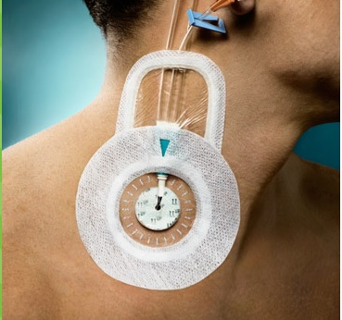
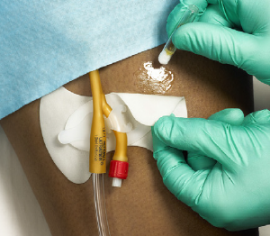
Mastisol® é um adesivo líquido não irritante de uso tópico aplicado na pele íntegra para reforçar a fixação de curativos.
Sem látex.
- Mastisol melhora o desempenho do adesivo de vários curativos e dispositivos oclusivos.
- Minimiza o risco de infecção, criando uma barreira duradoura oclusiva ao curativo, especialmente em torno dos locais CVC.

Slide 6
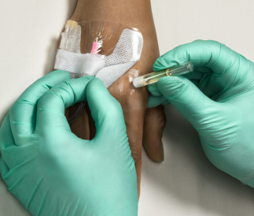
Forma uma barreira na pele que previne irritacão.
Não mancha a pele e roupa de cama.
Esteticamente agradável.
Uso em ambiente estéril.
Reduz o risco de contaminação cruzada.

Slide 7
Proposta de valor Adesivo Líquido Mastisol®
Resultados
Custo
Qualidade
Notes:
In this brief presentation, we will focus our conversation on 3 “segments” of value.
Of these, the 1st segment we are going to focus on is: OUTCOMES

Slide 8
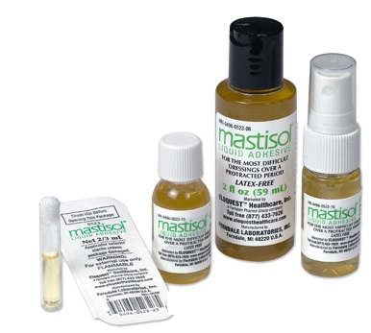
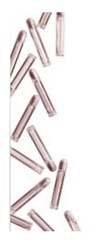
Mastisol possui registro CE e FDA

Slide 9
Referências Técnicas
1. Guidelines for the prevention of intravascular catheterrelated
infections. 2011. Centers for Disease Control website.
http://www.cdc.gov/hicpac/pdf/guidelines/bsi-guidelines-2011.pdf.
2. Guidelines for the prevention of catheter-associated urinary tract infections. 2009. Centers for Disease Control website. http://www.cdc.gov/hicpac/pdf/CAUTI/CAUTIguideline2009final.pdf.
3. GHX Market Data, Liquid Adhesives Class 10-036, 2012. 4. Lesesne CB. The postoperative use of wound adhesives: gum mastic versus benzoin, USP. J Dermatol Surg Onc.1992;18(11):990.
5. Timsit J, et al. Dressing disruption is a major risk factor for catheterrelated infections. Crit Care Med. 2012;40(6):1707-1714.
6. Safdar N, Maki DG. The pathogenesis of catheter-related bloodstream infections with noncuffed short-term central
venous catheters. Int Care Med. 2004; 30:62-67.
7. Patel N. The influence of tape type and of skin preparation on the force required to dislodge angiocatheters. Can J Anaesth. 1994;41:8:738-741.
8. SILVA, Louanna, et al. Cuidados intensivos com a pele do recém-nascido pré-termo https://www.fen.ufg.br/fen_revista/v11/n1/v11n1a22.htm

Slide 10
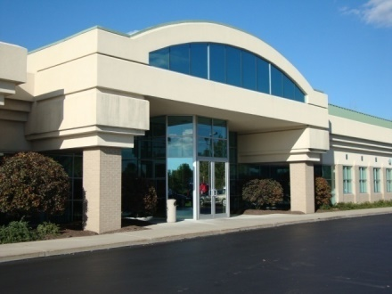
Bioargo Group é formado por empresas de desenvolvimento de negócios internacionais, através de escritórios no Rio de Janeiro e Nova York, além de rede de fabricantes, distribuidores, e representantes comerciais.
O foco do grupo no Brasil é a importação de produtos inovadores, de alta qualidade, sucesso no país de origem e que tragam soluções inteligentes na área médico-hospitalar.
A Bioargo Comercial LTDA é a importadora, distribuidora e representante legal dos produtos Detachol® e Mastisol® no Brasil.
Rio de Janeiro:  +55 21 2621-5565
Nova York: +1 716 568-4733
www.bioargo.com info@bioargo.com

